Slide 1
Library Management System
Ferhan Jamal 100953487

Slide 2
Problem Statement
Library Management System is an online library management software
It has arrived due to some flaws in the manual system
The basic problem in the manual system are as follows:
Management of books is very difficult in manual system
Preparing a list of borrowed and returned books is not proper
Availability of books can be known only by the staffs from the library in the manual system
Preparing a list of defaulters sometimes becomes nightmare for the
library staffs
Fast report generation takes a lot of time
Lastly, it is time-consuming and there is a possibility of errors
Above flaws calls for the automation of the library management system

Slide 3
Introduction
Basic aim of Library Management System is to handle entire functions in a library
It is a user-friendly software and it has been designed by keeping in mind the needs of the user
The basic operations possible from the library management system software are as follows:
Searching of books
Availability of books
Issuing of books
Adding books/magazines and new users
Updating books/magazine and new users
Deleting books/magazine and new users
Library Management System has computerize all the tasks in a library

Slide 4
Diagrams
a. Use Case Diagram
b. System Context Diagram
c. Class Diagram
d. Sequence Diagram
e. State Chart Diagram

Slide 5
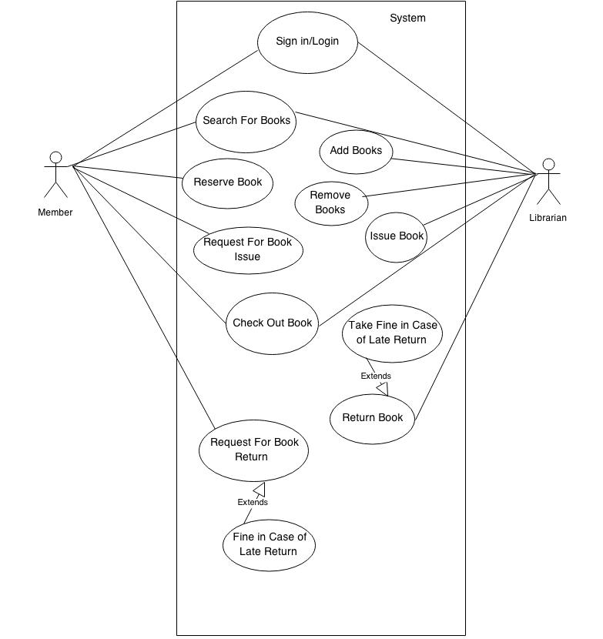
(a) Use Case Diagram

Slide 6
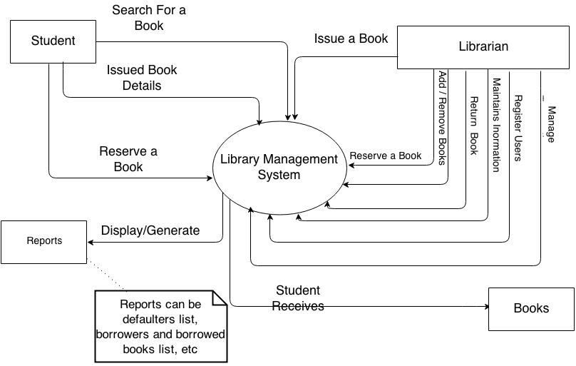
(b) System Context Diagram

Slide 7
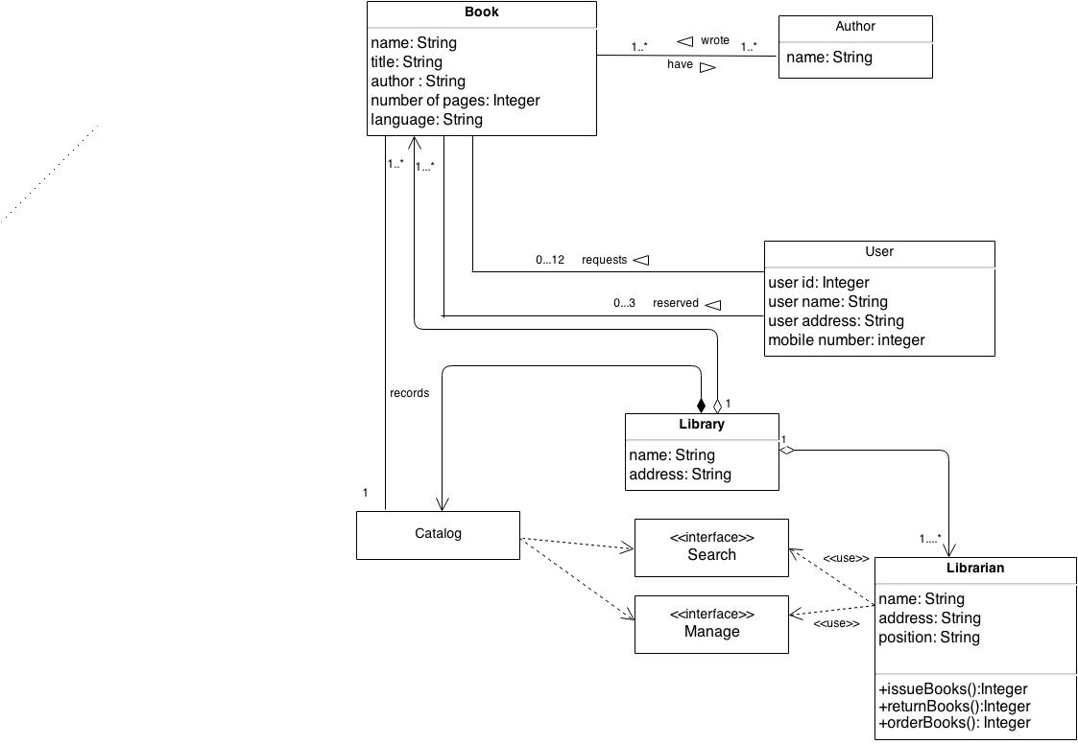
(c) Class Diagram

Slide 8
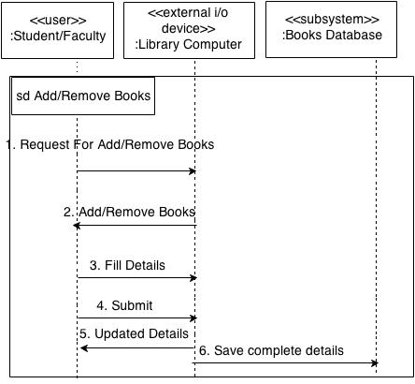
(d) Sequence Diagram

Slide 9
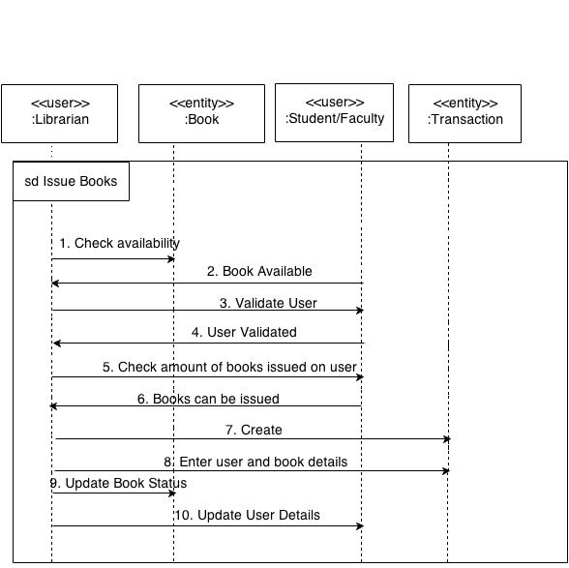
Sequence Diagram (contd..)

Slide 10
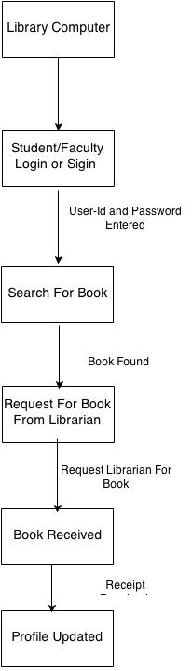
(e) State Chart Diagram

Slide 11
Project Outcome
To make present system more advanced
To make the functions of library work more faster
To make the library environment user-friendly and efficient
To decrease the workload and make life easier for employees

Slide 12
Limitations
Works with internet connection
Communication becomes negligible
Budget is very high in building this system

Slide 13
Thank You
Questions ?

